Slide 1
Go-back N ARQ and Selective Repeat ARQ

Slide 2
Flow and Error Control

Slide 3
Flow Control
Flow control coordinates the amount of data that can be sent before receiving acknowledgement
Flow control is a set of procedures that tells the sender how much data it can transmit before it must wait for an acknowledgement from the receiver.
Receiver has a limited speed at which it can process incoming data and a limited amount of memory in which to store incoming data.

Slide 4
Error Control
Error control includes both error detection and error correction.
It allows the receiver to inform the sender if a frame is lost or damaged during transmission and coordinates the retransmission of those frames by the sender.
Error control in the data link layer is based on automatic repeat request (ARQ).

Slide 5
Error and Flow Control Mechanisms
Stop-and-Wait
Go-Back-N ARQ
Selective-Repeat ARQ

Slide 6
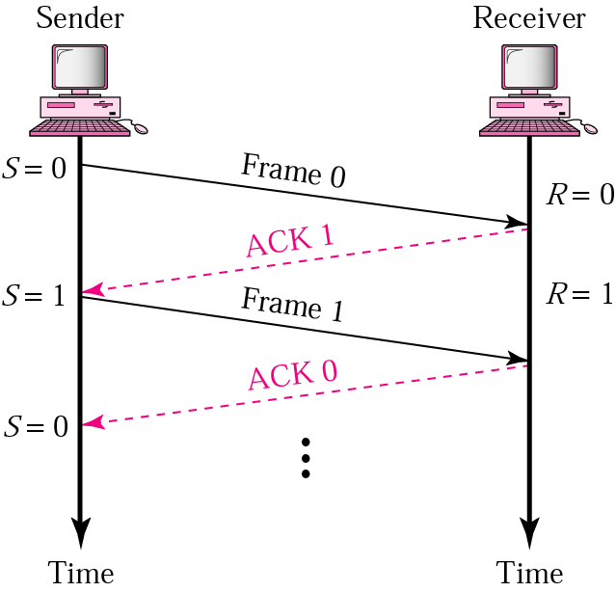
Stop-and-Wait
Sender keeps a copy of the last frame until it receives an acknowledgement.
For identification, both data frames and acknowledgements (ACK) frames are numbered alternatively 0 and 1.
Sender has a control variable (S) that holds the number of the recently sent frame. (0 or 1)
Receiver has a control variable ® that holds the number of the next frame expected (0 or 1).
Sender starts a timer when it sends a frame. If an ACK is not received within a allocated time period, the sender assumes that the frame was lost or damaged and resends it
Receiver send only positive ACK if the frame is intact.
ACK number always defines the number of the next expected frame

Slide 7
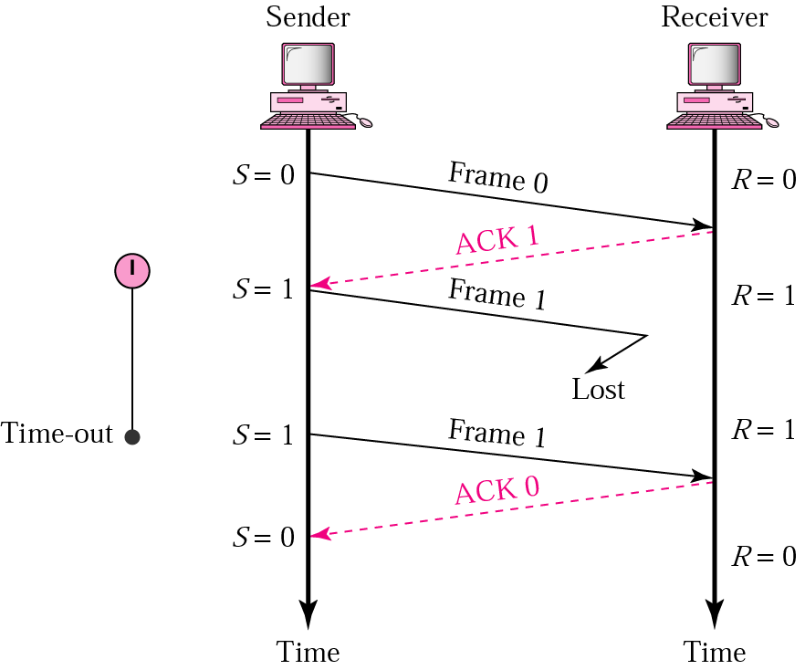
Stop-and-Wait ARQ, lost ACK frame
When a receiver receives a damaged frame, it discards it and keeps its value of R.
After the timer at the sender expires, another copy of frame 1 is sent.

Slide 8
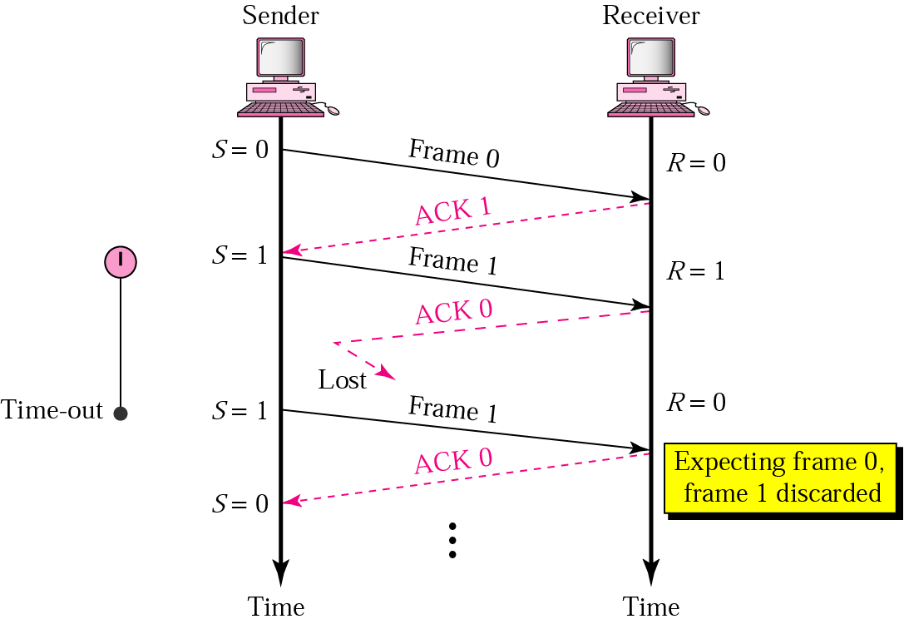
Stop-and-Wait, lost ACK frame
If the sender receives a damaged ACK, it discards it.
When the timer of the sender expires, the sender retransmits frame 1.
Receiver has already received frame 1 and expecting to receive frame 0 (R=0). Therefore it discards the second copy of frame 1.

Slide 9
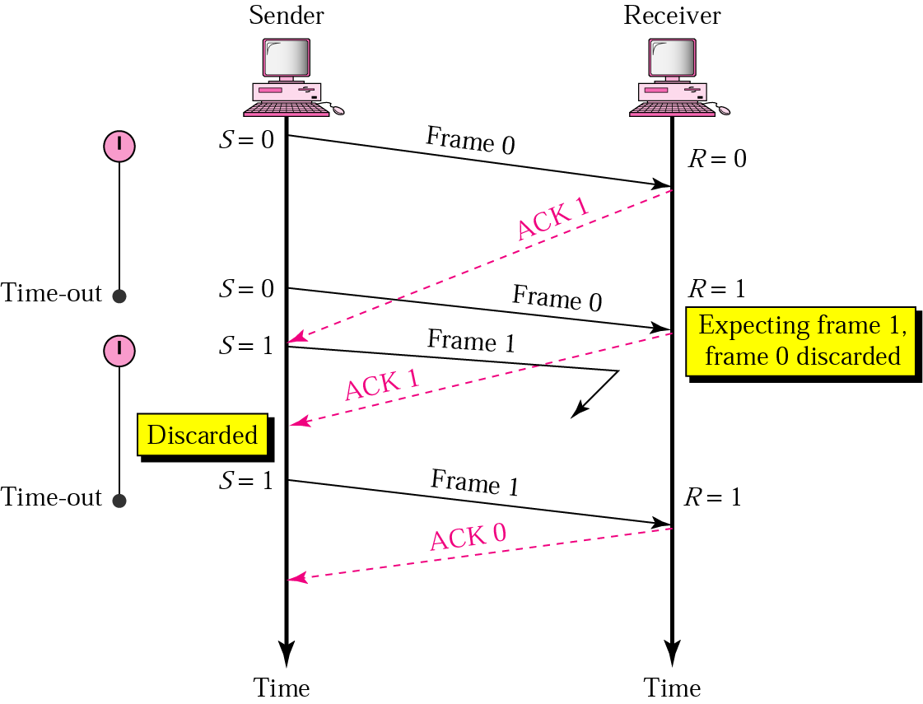
Stop-and-Wait, delayed ACK frame
The ACK can be delayed at the receiver or due to some problem
It is received after the timer for frame 0 has expired.
Sender retransmitted a copy of frame 0. However, R =1 means receiver expects to see frame 1. Receiver discards the duplicate frame 0.
Sender receives 2 ACKs, it discards the second ACK.

Slide 10
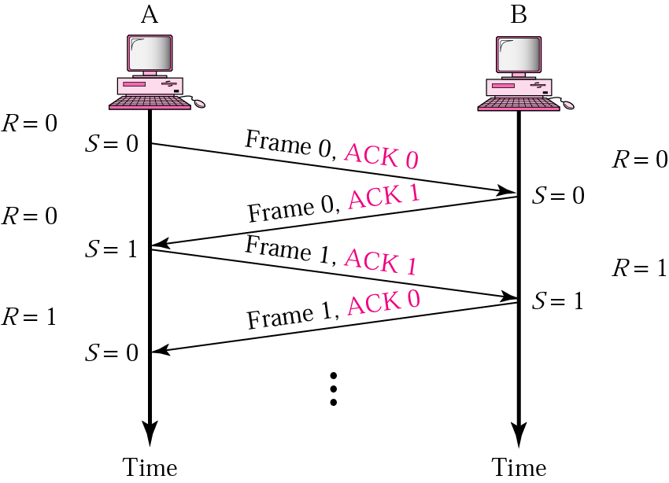
Piggybacking
A method to combine a data frame with ACK.
Station A and B both have data to send.
Instead of sending separately, station A sends a data frame that includes an ACK.
Station B does the same thing.
Piggybacking saves bandwidth.

Slide 11
Stop and wait channel efficiency
Efficiency = 1/(1+2a) where a = T_{p} / T_{t}
Throughput = Efficiency * Bandwidth

Slide 12
Disadvantage of Stop-and-Wait
only one frame that is sent and waiting to be acknowledged.
This is not a good use of transmission medium.
To improve efficiency, multiple frames should be in transition while waiting for ACK.
Two protocol use the above concept,
Go-Back-N ARQ
Selective Repeat ARQ

Slide 13
Go-Back-N ARQ
We can send up to W frames before worrying about ACKs.
We keep a copy of these frames until the ACKs arrive.
This procedure requires additional features to be added to Stop-and-Wait ARQ.

Slide 14
Sequence Numbers
Frames from a sender are numbered sequentially.
We need to set a limit since we need to include the sequence number of each frame in the header.
If the header of the frame allows m bits for sequence number, the sequence numbers range from 0 to 2 ^{m} – 1. for m = 3, sequence numbers are: 1, 2, 3, 4, 5, 6, 7.
We can repeat the sequence number.
Sequence numbers are:
0, 1, 2, 3, 4, 5, 6, 7, 0, 1, 2, 3, 4, 5, 6, 7, 0, 1, …

Slide 15
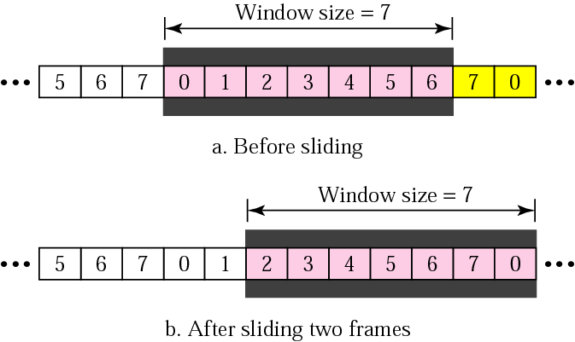
Sender Sliding Window
At the sending site, to hold the outstanding frames until they are acknowledged, we use the concept of a window.
The size of the window is at most 2^{m} -1 where m is the number of bits for the sequence number.
Size of the window can be variable, e.g. TCP.
The window slides to include new unsent frames when the correct ACKs are received

Slide 16
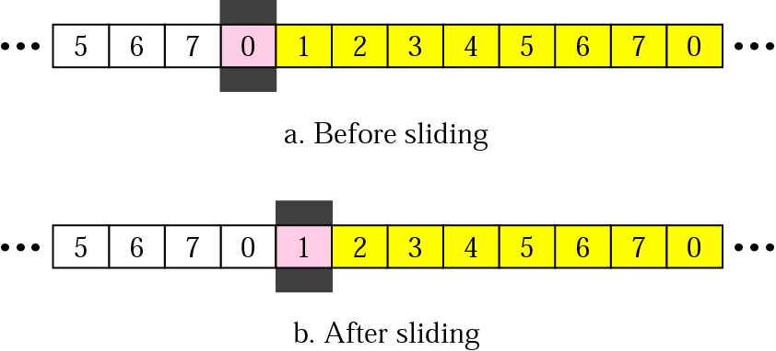
Receiver Sliding Window
Size of the window at the receiving site is always 1 in this protocol.
Receiver is always looking for a specific frame to arrive in a specific order.
Any frame arriving out of order is discarded and needs to be resent.
Receiver window slides as shown in fig. Receiver is waiting for frame 0 in part a.

Slide 17
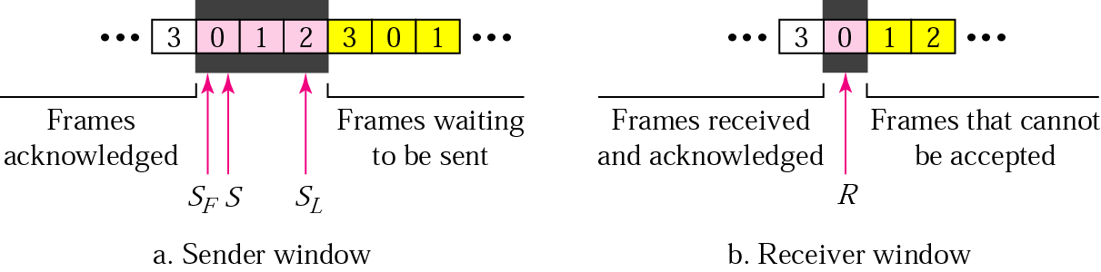
Control Variables
Sender has 3 variables: S, S_{F}, and S_{L}
S holds the sequence number of recently sent frame
S_{F} holds the sequence number of the first frame
S_{L} holds the sequence number of the last frame
Receiver only has the one variable, R, that holds the sequence number of the frame it expects to receive. If the seq. no. is the same as the value of R, the frame is accepted, otherwise rejected.

Slide 18
Acknowledgement
Receiver sends positive ACK if a frame arrived safe and in order.
If the frames are damaged/out of order, receiver is silent and discard all subsequent frames until it receives the one it is expecting.
The silence of the receiver causes the timer of the unacknowledged frame to expire.

Slide 19
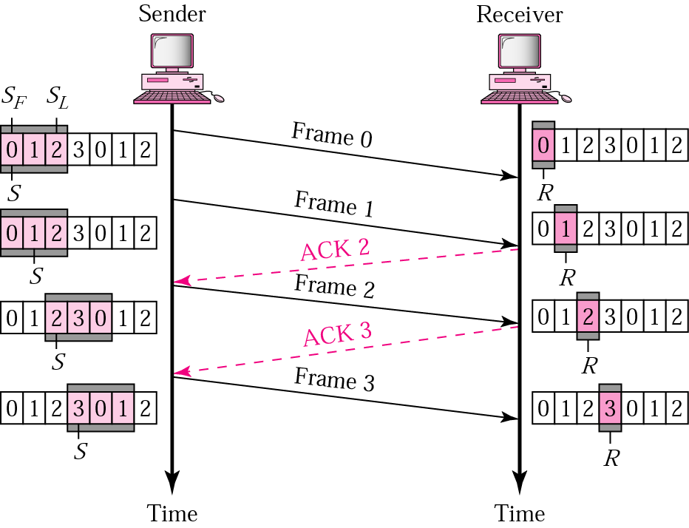
Go-Back-N ARQ, normal operation
The sender keeps track of the outstanding frames and updates the variables and windows as the ACKs arrive.

Slide 20
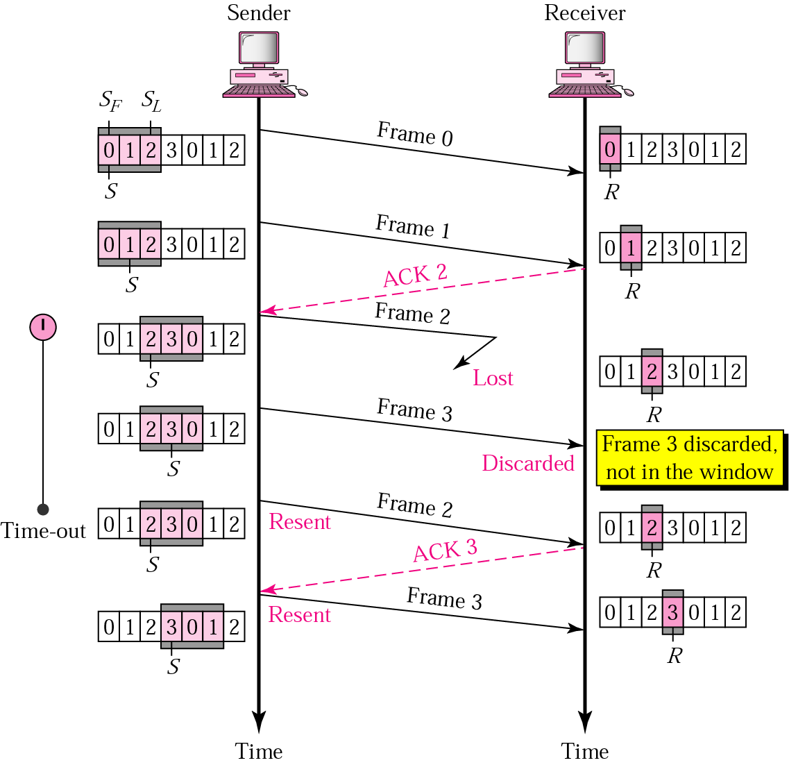
Go-Back-N ARQ, lost frame
Frame 2 is lost
When the receiver receives frame 3, it discards frame 3 as it is expecting frame 2 (according to window).
After the timer for frame 2 expires at the sender site, the sender sends frame 2 and 3. (go back to 2)

Slide 21
Go-Back-N ARQ, damaged/lost/delayed ACK
If an ACK is damaged/lost, we can have two situations:
If the next ACK arrives before the expiration of any timer, there is no need for retransmission of frames because ACKs are cumulative in this protocol.
If ACK1, ACK2, and ACk3 are lost, ACK4 covers them if it arrives before the timer expires.
If ACK4 arrives after time-out, the last frame and all the frames after that are resent.
Receiver never resends an ACK.
A delayed ACK also triggers the resending of frames

Slide 22
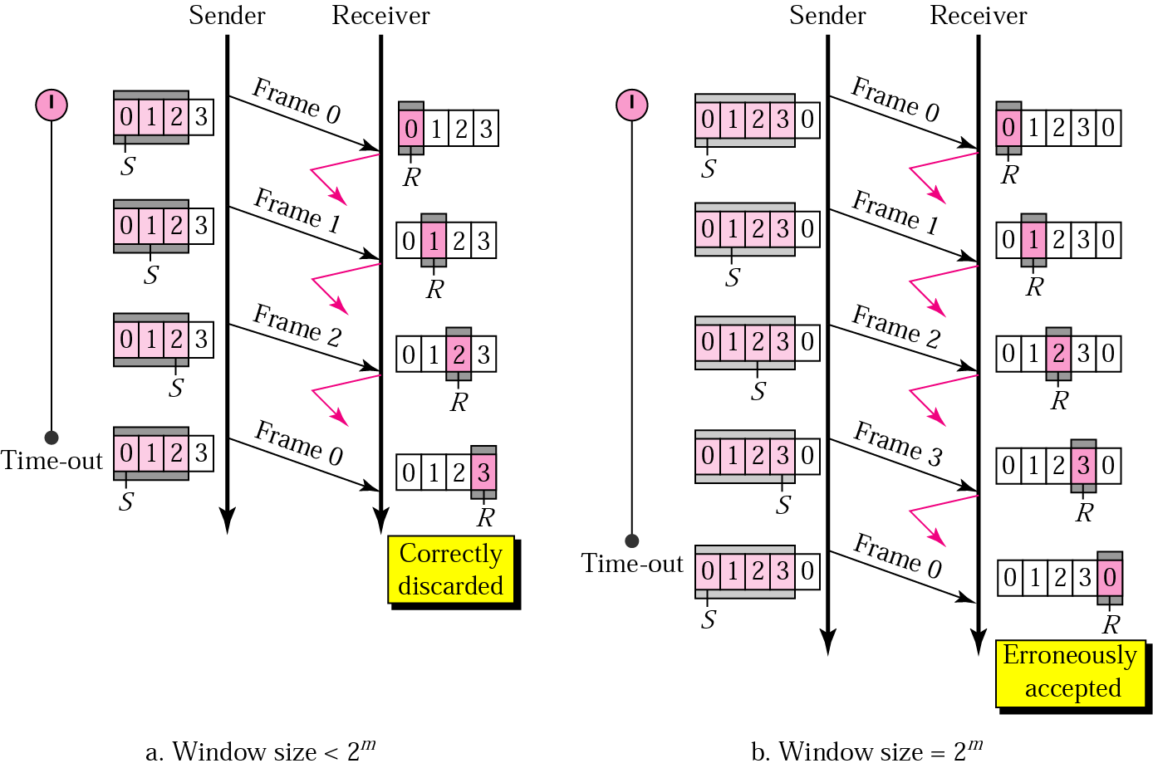
Go-Back-N ARQ, sender window size
Size of the sender window must be less than 2 ^{m}. Size of the receiver is always 1. If m = 2, window size = 2 ^{m} – 1 = 3.
Fig compares a window size of 3 and 4.
Accepts as the 1st frame in the next cycle-an error

Slide 23
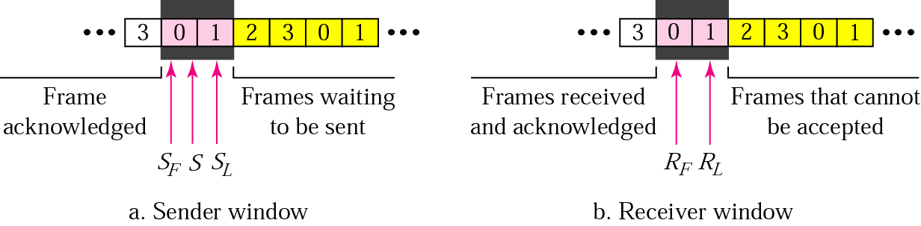
Selective Repeat ARQ, sender and receiver windows
Go-Back-N ARQ simplifies the process at the receiver site. Receiver only keeps track of only one variable, and there is no need to buffer out-of-order frames, they are simply discarded.
However, Go-Back-N ARQ protocol is inefficient for noisy link. It bandwidth inefficient and slows down the transmission.
In Selective Repeat ARQ, only the damaged frame is resent. More bandwidth efficient but more complex processing at receiver.
It defines a negative ACK (NAK) to report the sequence number of a damaged frame before the timer expires.

Slide 24
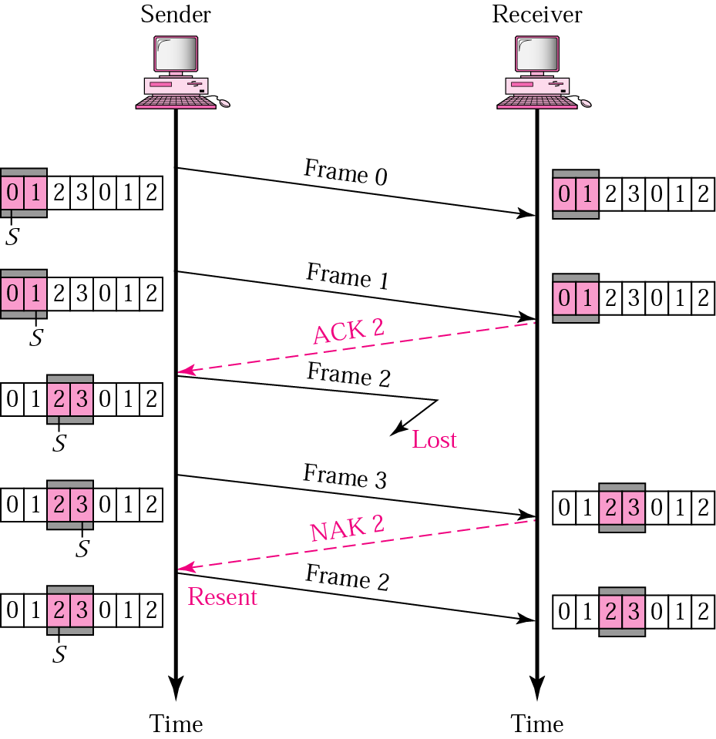
Selective Repeat ARQ, lost frame
Frames 0 and 1 are accepted when received because they are in the range specified by the receiver window. Same for frame 3.
Receiver sends a NAK2 to show that frame 2 has not been received and then sender resends only frame 2 and it is accepted as it is in the range of the window.

Slide 25
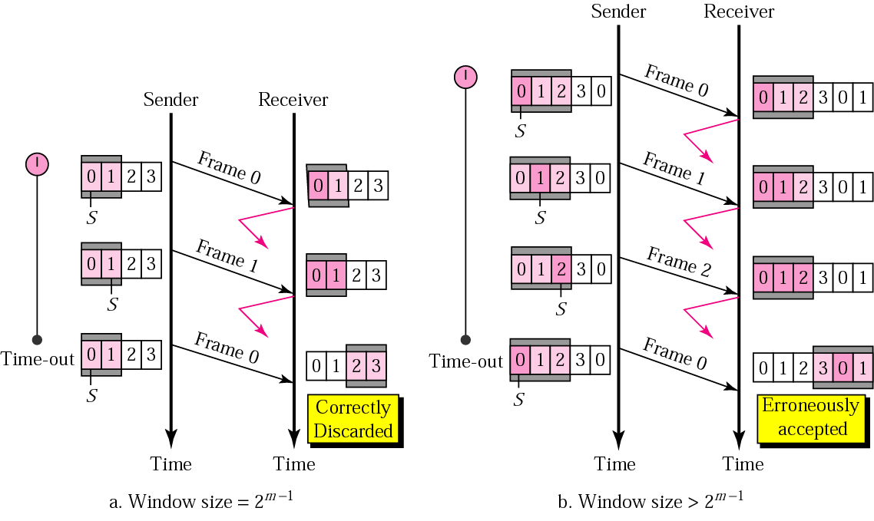
Selective Repeat ARQ, sender window size
Size of the sender and receiver windows must be at most one-half of 2 ^{m}. If m = 2, window size should be 2 ^{m} /2 = 2. Fig compares a window size of 2 with a window size of 3. Window size is 3 and all ACKs are lost, sender sends duplicate of frame 0, window of the receiver expect to receive frame 0 (part of the window), so accepts frame 0, as the 1st frame of the next cycle – an error.

Slide 26
Stop and wait channel efficiency
Efficiency = 1/(1+2a) where a = T_{p} / T_{t}
Go back n and selective Repeat channel efficiency
Efficiency Of GBN = N/(1+2a)
where a = Tp/Tt
Effective Bandwidth or Throughput = Efficiency * Bandwidth = (N/(1+2a)) * B

Slide 27
GBN Problem
A link has a transmission speed of 500 × 10⁶ bpsec. Assume acknowledgment has negligible transmission delay, and its one way propagation delay is 2 sec. Also assumes that the processing delays at nodes are also negligible. If data packet size is 10⁷ bits, then the efficiency of Go-Back-7 protocol is _______ (in %)
Tp = 2 sec Tt = Packet Size / Bw = 10^7 bits / 500 * 10^6 bits per sec = 0.02 sec Efficiency = W / 1+2a = 7 / (1 + 2 * 2/0.02) = 0.0348 = 0.0348 * 100 = 3.48%

Slide 28
In GBN sender Window size = 10 and T_{p} = 49.5ms & T_{t} = 1ms. What is the Efficiency of the protocol and Throughput given Bandwidth = 1000 bps?
Efficiency = N/(1+2a), N = 10 (given),
a = T_{p}/T_{t} = 49.5 Efficiency = 10/(1 + 2 * 49.5) = 10/100 = 0.1 or 10% Throughput = Efficiency * Bandwidth n = 0.1 * 1000 = 100bps

Slide 29
GATE Previous Years Questions
The maximum window size for data transmission using the selective reject protocol with n-bit frame sequence numbers is:
2^{n}
2^{n-1}
2^{n}-1
2^{n-2}

Slide 30
GATE Previous Years Questions
A link has a transmission speed of 10⁶ bits/sec. It uses data packets of size 1000 bytes each. Assume that the acknowledgement has negligible transmission delay, and that its propagation delay is the same as the data propagation delay. Also assume that the processing delays at the nodes are negligible. The efficiency of the stop-and-wait protocol in this setup is exactly 25%. The value of the one-way propagation delay (in milliseconds) is ___________.
Tp = 2 sec Tt = 8000/ 10^6 = 0.008 .25 = 1 / 1+2(tp/tt)
¼= 1/( 1+ (tp*10-3)/4)
1+ (tp* 103)/4 = 4 => 3*4 = 12

Slide 31
Consider a 128 × 10³ bits/second satellite communication link with one way propagation delay of 150 milliseconds. Selective retransmission (repeat) protocol is used on this link to send data with a frame size of 1 kilobyte. Neglect the transmission time of acknowledgement. The minimum number of bits required for the sequence number field to achieve 100% utilization is _________.
Tp = 150 milliseconds = 0.15 Tt = 8000/ 128 × 10³ = 1/16 1= W / 1+(2* 0.15*16)
W= 1+(2* 0.15*16)= 5.8 = 4

Slide 32
A sender uses the Stop-and-Wait ARQ protocol for reliable transmission of frames. Frames are of size 1000 bytes and the transmission rate at the sender is 80 Kbps (1Kbps = 1000 bits/second). Size of an acknowledgment is 100 bytes and the transmission rate at the receiver is 8 Kbps. The one-way propagation delay is 100 milliseconds. Assuming no frame is lost, the sender throughput is __________ bytes/second
Tp = 100* 10^-3 = 0.1 Tt = 8000/ 80000 = 0.1
=(1/(1+1))=1/2
=1/2 = ¼* 80000 = 20000/8

Slide 33
Consider a network connected two systems located 8000 kilometers apart. The bandwidth of the network is 500 × 10⁶ bits per second. The propagation speed of the media is 4 × 10⁶ meters per second. It is needed to design a Go-Back-N sliding window protocol for this network. The average packet size is 10⁷ bits. The network is to be used to its full capacity. Assume that processing delays at nodes are negligible. Then the minimum size in bits of the sequence number field has to be ___________.

Slide 34
Two hosts are connected via a packet switch with 10⁷ bits per second links. Each link has a propagation delay of 20 micro-seconds. The switch begins forwarding a packet 35 microseconds after it receives the same. If 10000 bits of data are to be transmitted between the two hosts using a packet size of 5000 bits, the time elapsed between the transmission of the first bit of data and the reception of the last bit of the data in microseconds is____________.

Slide 35
Two hosts are connected via a packet switch with 10⁷ bits per second links. Each link has a propagation delay of 20 microseconds. The switch begins forwarding a packet 35 microseconds after it receives the same. If 1000 bits of data are to be transmitted between the two hosts using a packet size of 5000 bits, the time elapsed between the transmission of the first bit of data and the reception of the last of the data in microsecond is _________.

Slide 36
Suppose that the stop-and-wait protocol is used on a link with a bit rate of 64 kilobits per second and 20 milliseconds propagation delay. Assume that the transmission time for the acknowledgment and the processing time at nodes are negligible. Then the minimum frame size in bytes to achieve a link utilization of at least 50% is _________.
T_{p} =
B_{w}= T_{t} = Packet Size / Bw =
Efficiency = Efficiency = 1 / 1+2a

Slide 37
Consider a selective repeat sliding window protocol that uses a frame size of 1 KB to send data on a 1.5 Mbps link with a one-way latency of 50 msec. To achieve a link utilization of 60%, the minimum number of bits required to represent the sequence number field is ________.
T_{p} =
B_{w}= T_{t} = Packet Size / Bw =
Efficiency = Efficiency = W / 1+2a

Slide 38
Problem 2
In GB3 if every 5th packet is lost & we need to send 10 packets so how many retransmissions are required ?
1 2 3 4 5 6 7 | 8 9 10
^ $ (packet no. 5 lost)
1 2 3 4 5 6 7 5 6 7 8 9 | 10
* ^ $
1 2 3 4 5 6 7 5 6 7 8 9 7 8 9 10
* ^ $
1 2 3 4 5 6 7 5 6 7 8 9 7 8 9 10 9 10 (count starts from * till ^)
(from ^ to $ retranmission is done)

Slide 39
Go-Back N
When an error occurs the entire window of N packets must be retransmitted
Efficiency = 1-P

Slide 40
Efficiency of Go Back N with transmission errors Approximate analysis
When an error occurs the entire window of N packets must be retransmitted
Let X = the number of packets sent per successful transmission
E[X] = 1*(1-P) + (X+N)*P = 1 + N*P/(1-P)
Efficiency = 1/E[X]

